Slide 1


2017
Annual
General
Meeting

Slide 2

THANK YOU

Slide 3

THANK YOU
RPCVCO

Slide 4

THANK YOU
Sponsors

Slide 5

Conference
Sustainability
RPCVS FOR ENVIRONMENTAL ACTION

Slide 6

THANK YOU
Speakers
Board Members
Women of Peace Corps Legacy
Everyone who made This Conference Possible

Slide 7
32%
A Successful
TRANSITION
Increase in contributions
after going membership free
2016 financial statements

Slide 8
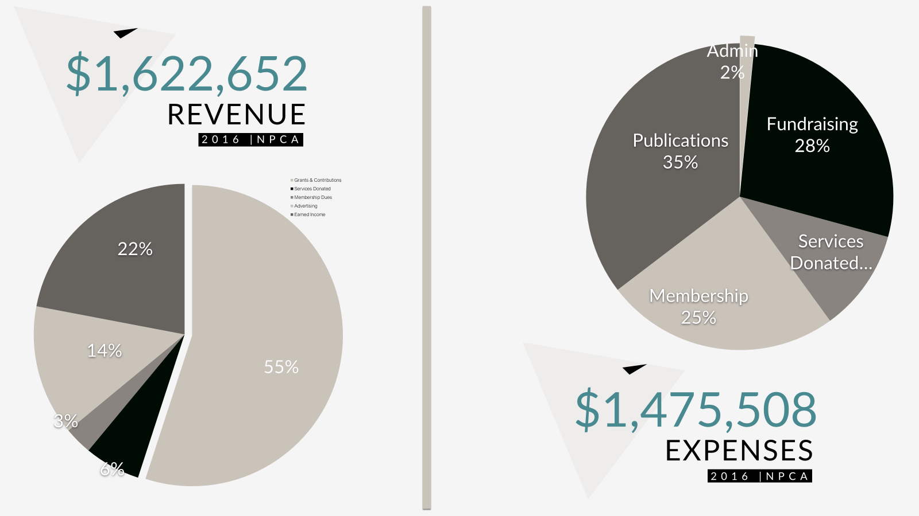

Slide 9

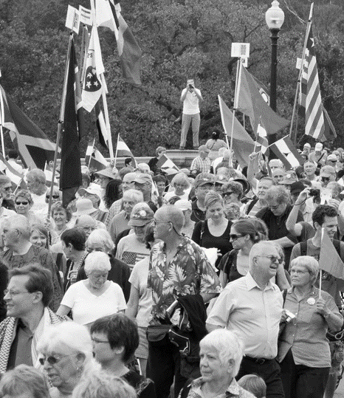

Bigger & Better
Peace Corps
Thriving
Community
Amplified
IMPACT
Bigger & Better
More local and national touchpoints then ever before.
More
affiliate groups with more members and resources than ever before.
More
support for projects than ever before.

Slide 10

BIGGER, BETTER PEACE CORPS
#ProtectPEACECORPS
More local and national touchpoints then ever before.

Slide 11

SKINNY BUDGET
What we Faced
POTUS
March 16th 2017 – Skinny Budget Released

Slide 12
SKINNY BUDGET
Cuts
March 16th 2017 – Skinny Budget Released

Slide 13


A
ADVOCACY
#PROTECTPEACECORPS
BIGGER, BETTER
PEACE CORPS
450 | meetings
29k | E-mails
195 | Signees

Slide 14
2.7%
51%
100%
11%
POTUS FY18
12%
PROPOSED CUTS
39%
43%
#PROTECTPEACECORPS

Slide 15
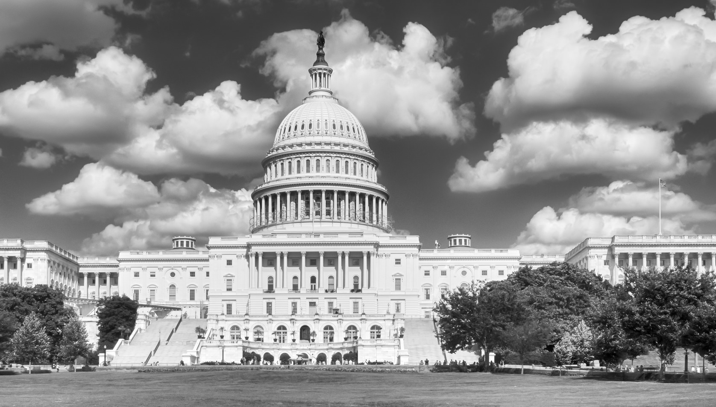
ADVOCACY
& Our Path Forward

Slide 16
Health &
Safety ADVOCACY
improving health and safety for currently serving Peace Corps Volunteers and addressing health care needs of RPCVs with injuries and illnesses stemming from their service

Slide 17
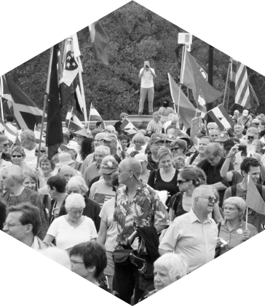
Thriving Community
#UNIFIED
More affiliate groups with more members and resources than ever before.

Slide 18
National Peace Corps Association
Cycle of Growth
Membership
Our membership model is more accessible than ever. The new membership model is thriving..
01
Increased Visibility
A new website, improved AdWords and social media efforts such as thunderclap have put NPCA in front of more people than ever before.
04
02
Increased Impact
03
Easier Access to Engagement
A larger and more equipped Peace Corps community is resulting in more impact than ever.
Once members are in our system they are provided “single action” engagement tools.

Slide 19

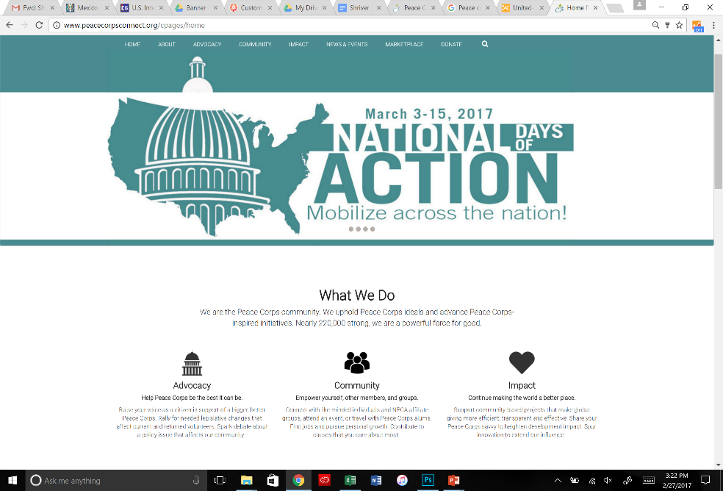
National Peace Corps Association
New PeaceCorpsConnect.Org
A dynamic new website is bringing our community closer and magnifying our community’s effort. Designed to support local chapters and the NPCA database - our members can rally behind our advocacy efforts, engage on targeted social campaigns and purchase the newest Peace Corps merchandise all in one place.
Merged Database
Community Calendar
Group Micro-sites
Impact Campaigns
New Merchandise
Action oriented
RPCV Directory
Integrated messaging

Slide 20
National Peace Corps Association
National Coverage
State Groups
In the Process

Slide 21
National Peace Corps Association
Domestic Dividend
RPCVs promote greater cross-cultural awareness and understanding of other peoples on the part of Americans
We ensure that all affiliate groups have the ability to organize effective domestic dividend: activities (such as film festivals, storytelling events, advocacy engagements, and so on.
Over 50% of all RPCVs volunteer at double
the national average. *call to peace study*
With the current divisive climate in the United States, our goodwill ambassadors are needed in a more deliberate capacity.

Slide 22
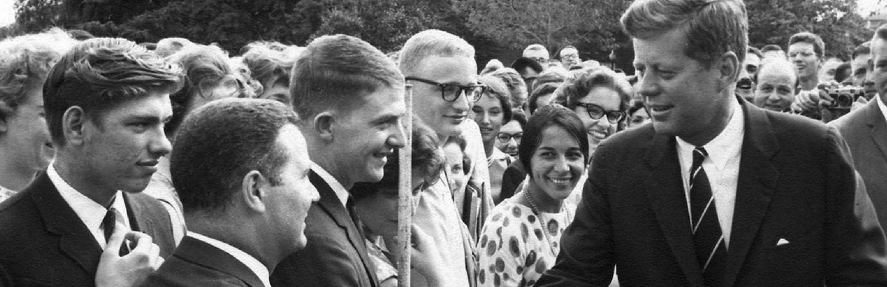
Mission-driven
Market-minded
Our business model is thriving. Another net increase in unrestricted assets in 2016 further strengthens our financial foundation, predominantly a combination of earned income and individual contributions. We are a purposeful non-profit, but when it comes to impact, we mean business.

Slide 23

Amplified IMPACT
Global Development
More support for projects than ever before.

Slide 24
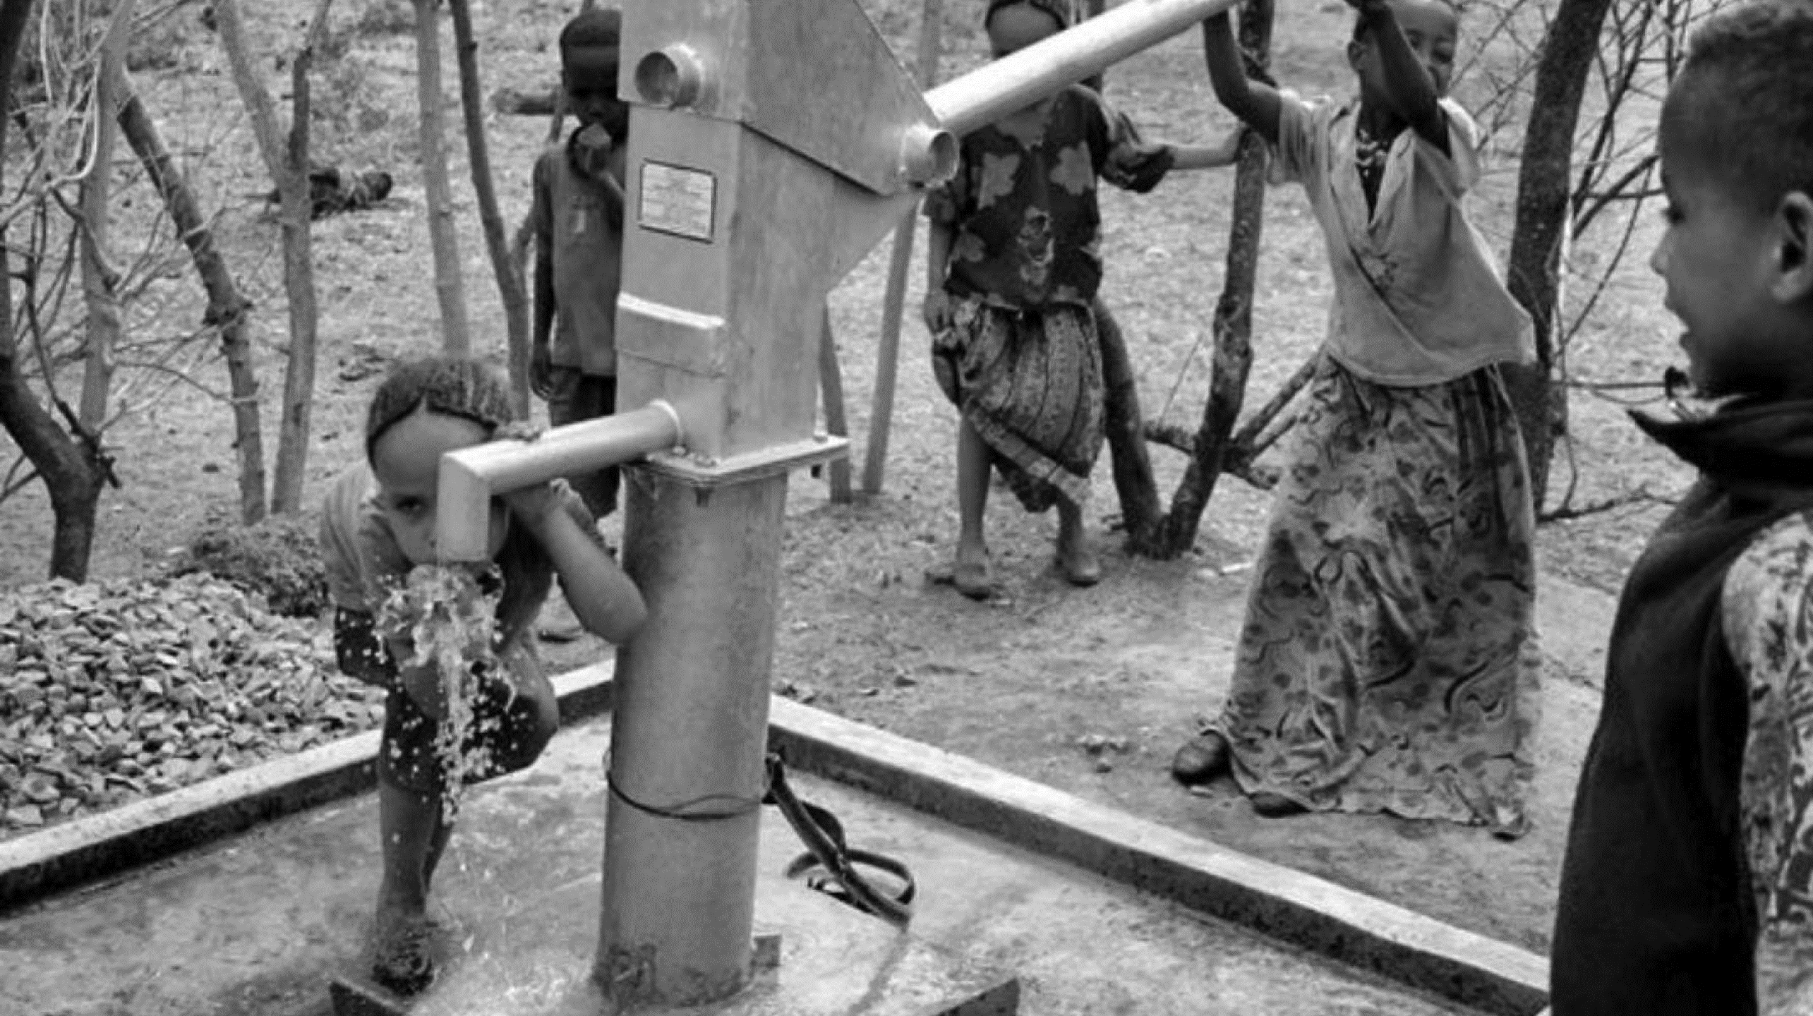
Partnering FOR PROSPERITY
Support FOR PCPP

Slide 25
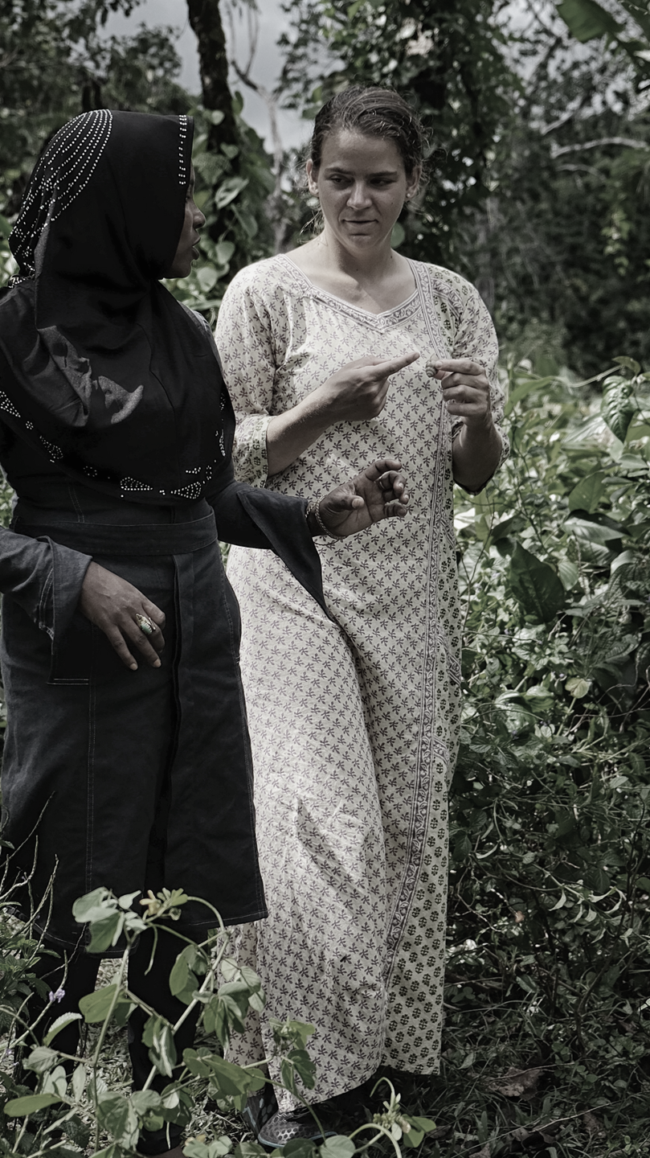
$394,746 Mobilized
DEVELOPMENT
IMPACT
137 Project Funded
WORLDWIDE
546,628 Lives reached
Trending Growth in 2017

Slide 26

Next Step Travel
360-degree itineraries that combine unparalleled local
access, cultural immersion, and non-extreme adventure, all with the unique Peace Corps perspective.
OCT. 8-21-2017
APR. 22-May-05 -2018
OCT. 7-20-2018
DEC. 6-11-2017
Kazakhstan
MOROCCO
ICELAND
Colombia
Kyrgyzstan
NOV. 9-13-2017
Sept. 2-15-2017

Slide 27
Thank You
2017
Annual
General
Meeting

